Slide 1
Smart Connect – Supplier Portal Training
Module 1 – System Overview

Slide 2
Cairn India has launched the ‘Smart Suite’ of solutions to enable better integration with its partners
Smart Source (Launched on 14th August 2012)
A web-platform for conducting sourcing and tendering activities, enabling online submission of bids by suppliers and online evaluation of bids by Cairn
Smart Connect (Launched on 18th December 2012)
A web based portal for our business partners to simplify transactions, automate order execution and accelerate payment processes for goods and services

Slide 3
Cairn Smart Connect- Benefits to Suppliers
PO Visibility
Advanced Notification
GRN / SES
Invoice Payment Status
We expect the following benefits to Suppliers from the Smart Connect system :
Faster Supplier Payment Processing
Real time GRN/SES notifications to suppliers
Regular payment status update to suppliers
Greater Information Visibility
Real time intimation of POs / Callouts to suppliers
Advanced dispatch & service information from Suppliers
Improved Functionality & Ease of transactions
Simple web-enabled interface to carry out all key transactions
Online document submission for related activities

Slide 4
Key Functionalities
Benefits | Key Functionalities / changes to existing process
PO Visibility | POs / Callouts released in SAP to be made visible to the suppliers on Portal Any amendment in the PO to be auto replicated on portal Contracts will not be transferred through the Portal Upfront callout / limit PO / purchase order mandatory for subsequent steps
Material Supply | For Materials Suppliers to submit Advance Shipment Notification (ASN) on Portal including documents required with material delivery GRN creation notification to be provided to suppliers on real-time basis
Service Execution | For services, suppliers to submit Service notification on portal along with scanned copy of field ticket confirmations Users can fully approve or reject the Service notification which automatically creates SES in SAP
Payment Status | Payment status updates to be available to all Suppliers Invoice Status to be updated to suppliers on regular basis Cases where vendor action required actual reason visible to suppliers

Slide 5
Navigation on Portal

Slide 6
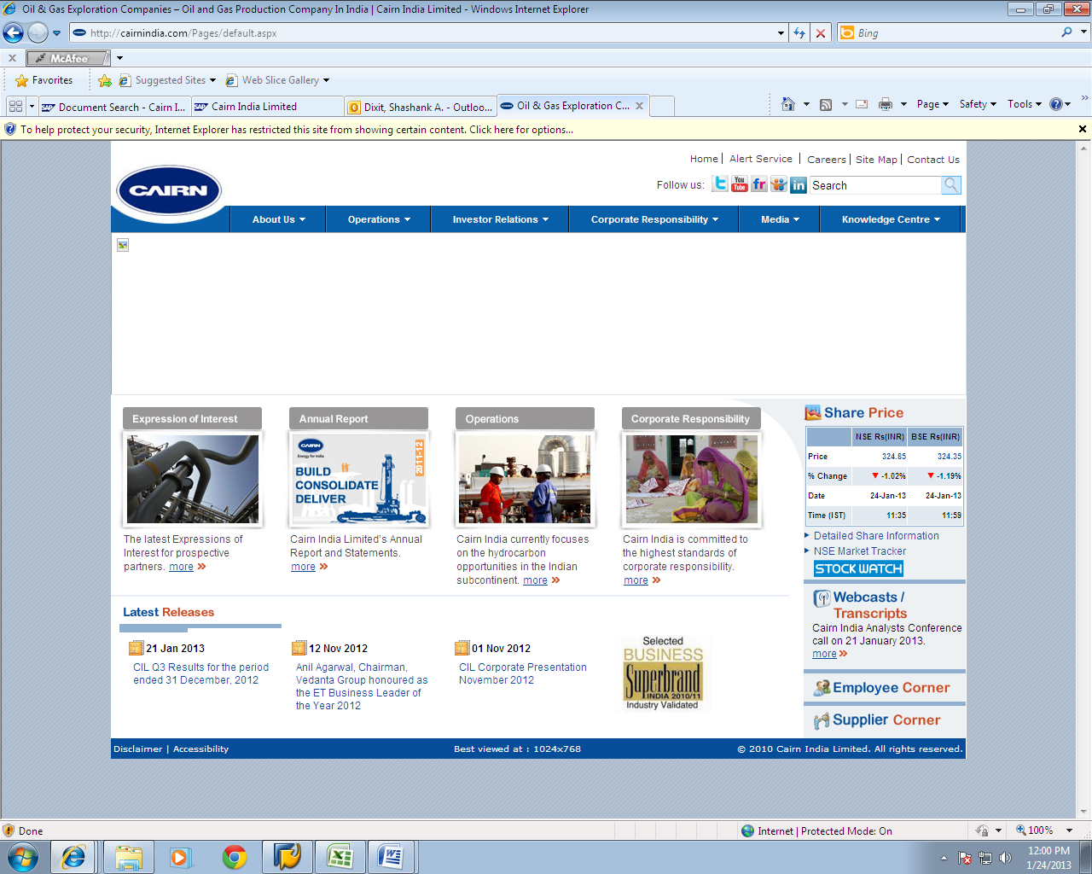
Suppliers can access the Supplier Corner section on Cairn India Website to access all relevant information around working with Cairn
Click on Supplier Corner Tab
* Based on sample data

Slide 7
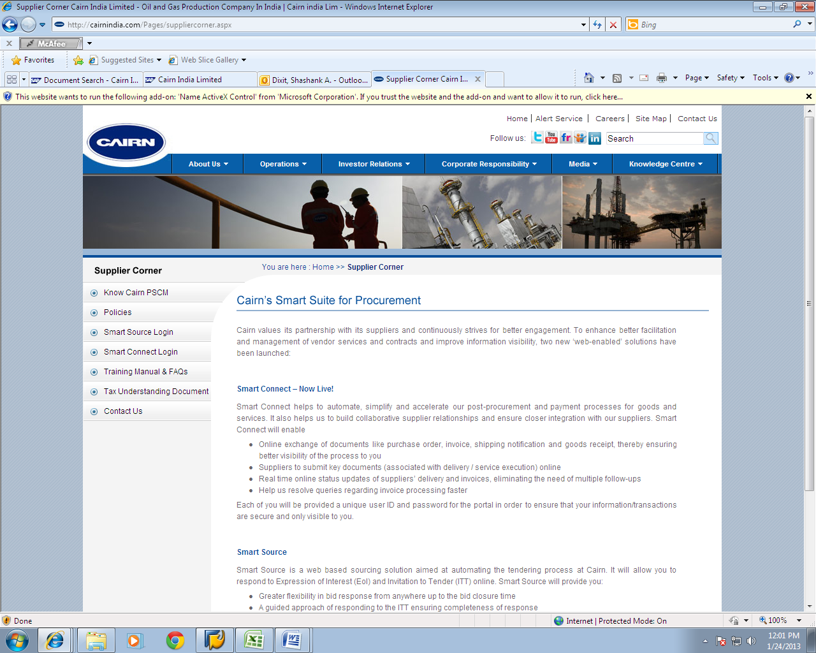
Please click on Smart Connect Login link
User Manuals and FAQs can be accessed through the next link
All Existing suppliers with Smart Connect logins can access the system through the Smart Connect Login link
* Based on sample data

Slide 8
Please enter the login id and password provided to you by the Smart Connect Team
Incase you have forgotten your password the same can be reset by clicking here. The new password will be sent to your registered email id
You will be directed to this page to access the Portal
* Based on sample data

Slide 9
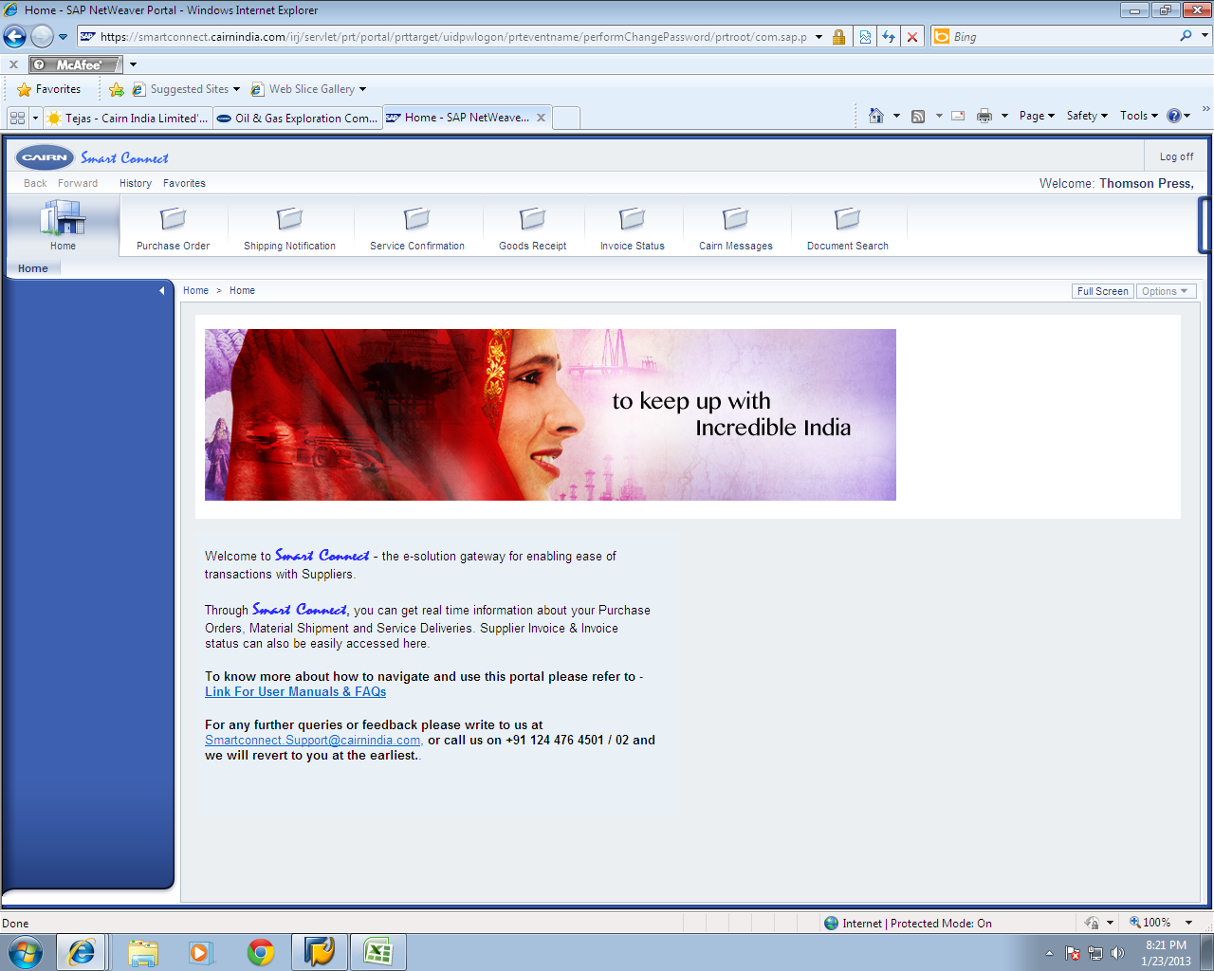
All relevant information can be accessed by clicking on the respective tabs above
Upon successful submission of login details you will be directed to your home page on the Smart Connect Portal
* Based on sample data

Slide 10
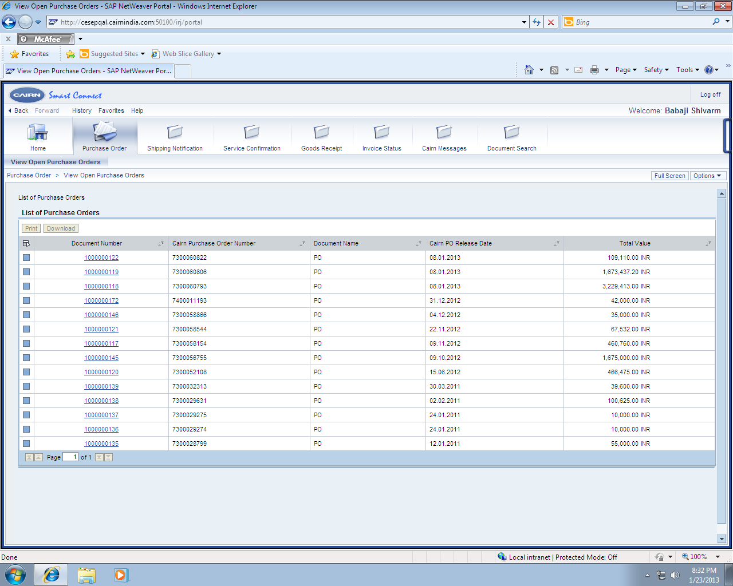
Please click on the link to access the PO details
The Purchase Order Tab displays a list of all the purchase orders/ Service Orders / Callout Orders released to you by Cairn, along with Release date and value
* Based on sample data

Slide 11
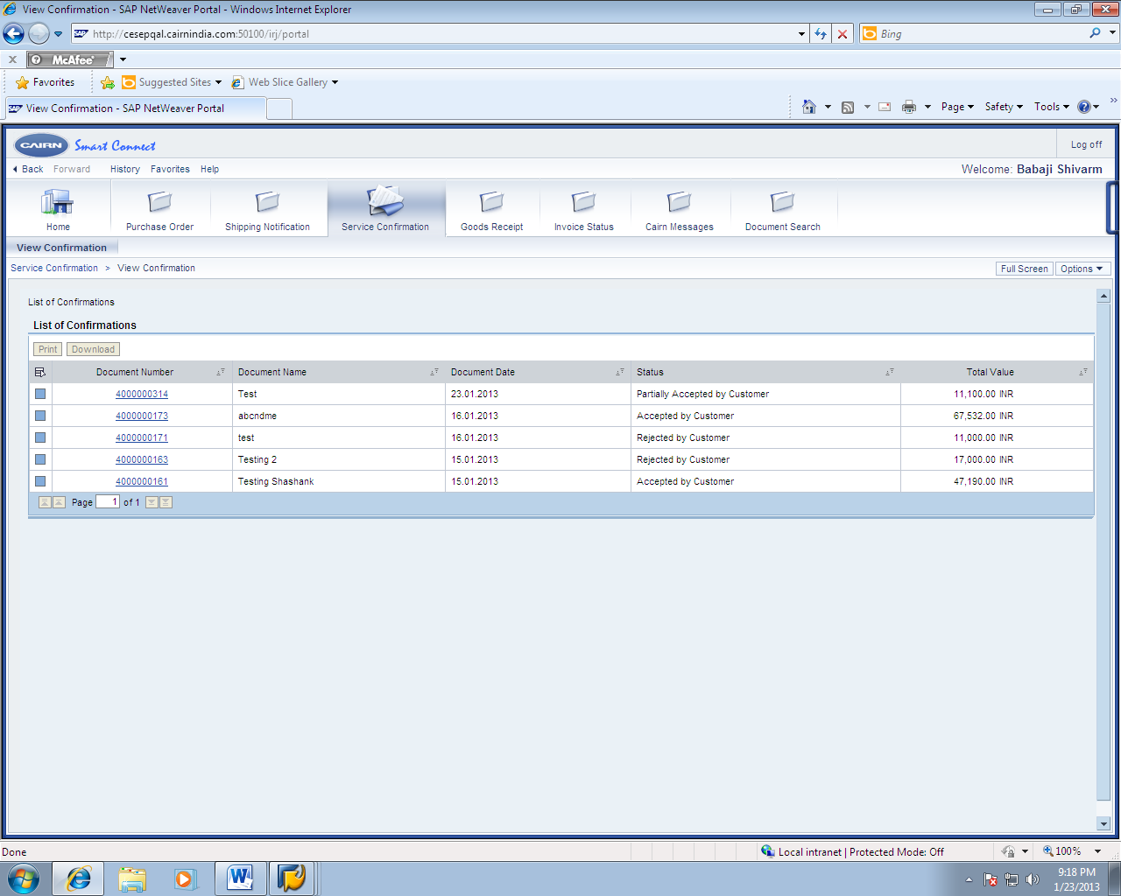
Click here to open a previously submitted confirmation
Status of a submitted confirmation can be seen here
The Confirmations Tab displays a list of all the Service confirmations submitted to Cairn along with the current status of the confirmation. Further details can be accessed by opening a confirmation
* Based on sample data

Slide 12
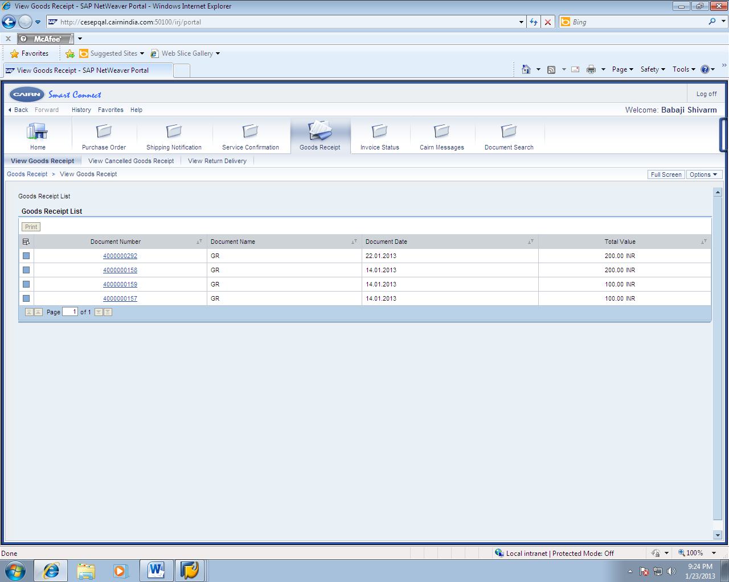
Any rejections/ return deliveries can be viewed here
A Cancelled GRN can be viewed by clicking here
Click here to view the details of a GRN created by Cairn
The Goods Receipt Tab displays a list of all the Goods Receipt created by Cairn Further details can be accessed by opening a Goods Receipt.
* Based on sample data

Slide 13
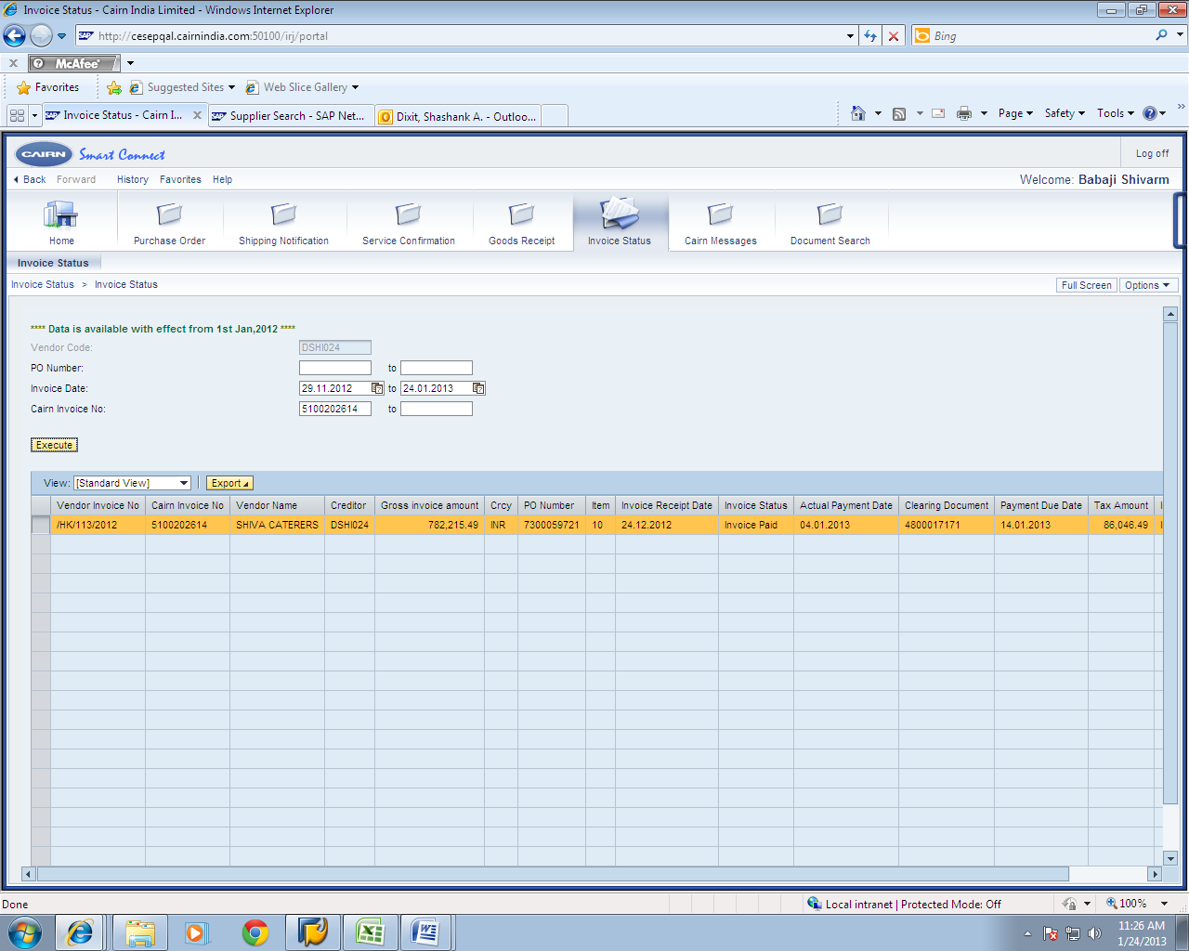
1. Enter the Cairn PO number (if available)
2. Enter the date range in which the invoice was raised
3. Click on execute
The Invoice status Tab displays a list of all the Invoices received at the Cairn Invoice Processing BPO at Noida. The invoice can be searched by putting appropriate PO number, vendor invoice date (mandatory field) or Cairn Invoice number
* Based on sample data

Slide 14
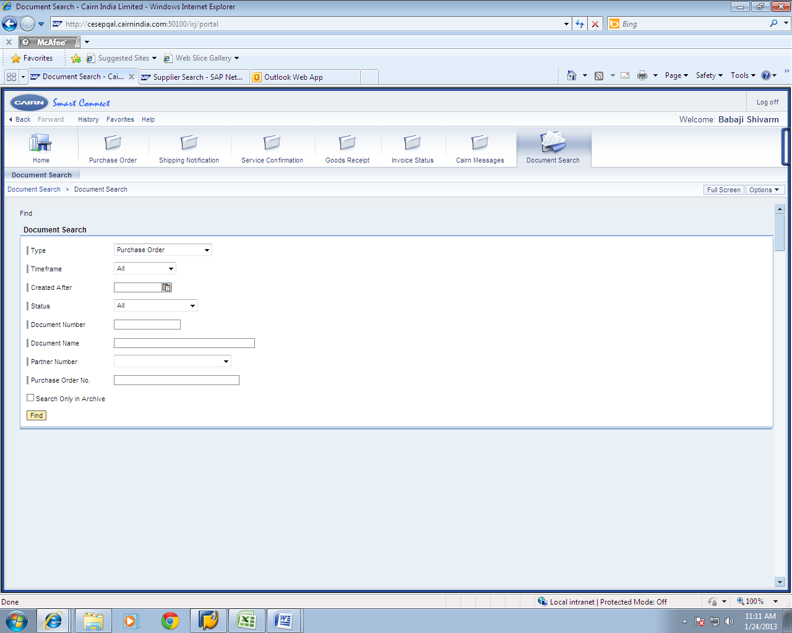
1. Enter the document type to be searched
Document Search option can be used to directly access a PO/Service Confirmation / Shipment Notification / GRN on the Portal. Invoice cannot be searched here. (please go to invoice status tab to access an invoice)
* Based on sample data

Slide 15
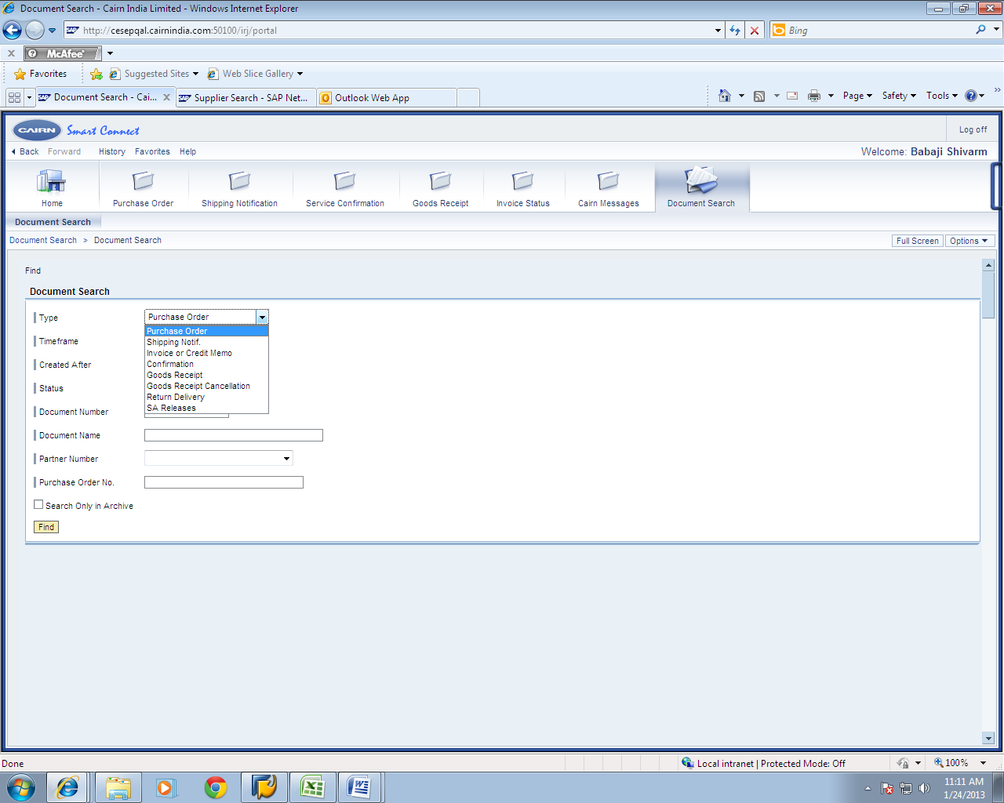
1. Enter the document type to be searched
Document Search option can be used to directly access a PO/Service Confirmation / Shipment Notification / GRN on the Portal. Invoice cannot be searched here. (please go to invoice status tab to access an invoice)
* Based on sample data

Slide 16
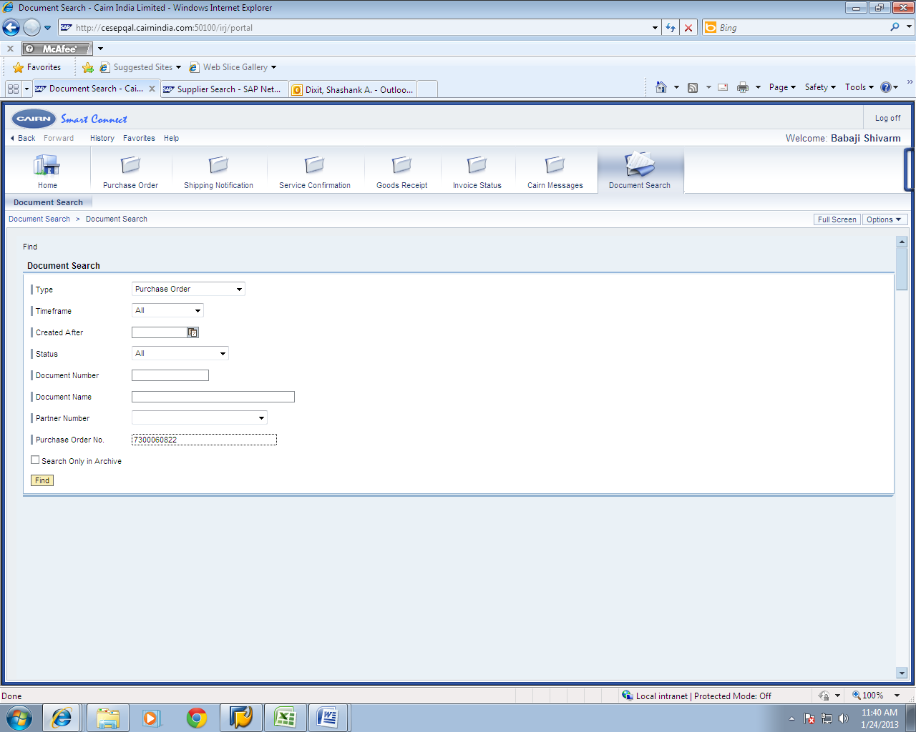
2. Enter the smart connect reference number if available
3. Cairn PO can be directly searched by entering here
4. Click on Find to search the document
Document Search option can be used to directly access a PO/Service Confirmation / Shipment Notification / GRN on the Portal. Invoice cannot be searched here. (please go to invoice status tab to access an invoice)
* Based on sample data

Slide 17
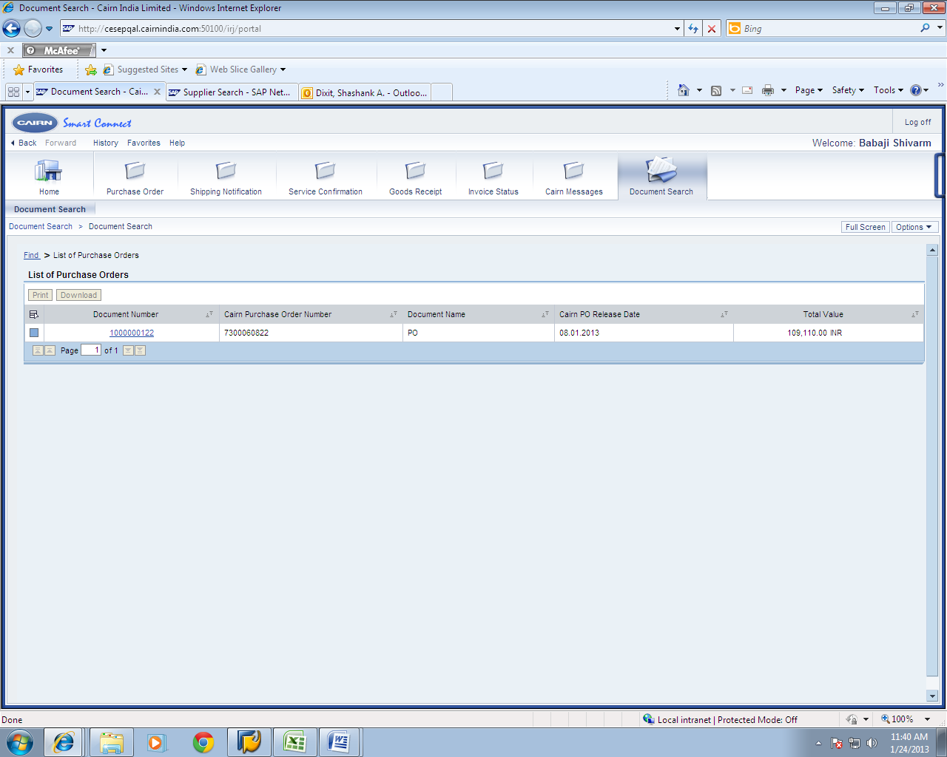
System will return the searched document. Click here to view details
* Based on sample data

Slide 18
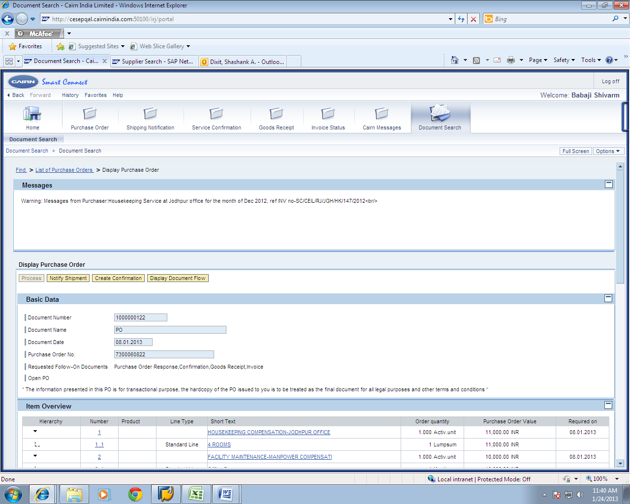
Details of the searched Document
* Based on sample data

Slide 19
Incase you still face some issues in navigating the system please feel free to write to us / call us on the details provided
* Based on sample data

Slide 20
Thank You

